Slide 1
Insights for Microsoft’s New Movie Studio
Data-Driven Recommendations for Film Success and Profitability
By Jerry Mandela

Slide 2


Microsoft wants to enter the film industry by producing original content. There are a lot of genres to choose from however the nature of selection is to be based on popularity and profitability.

Slide 3
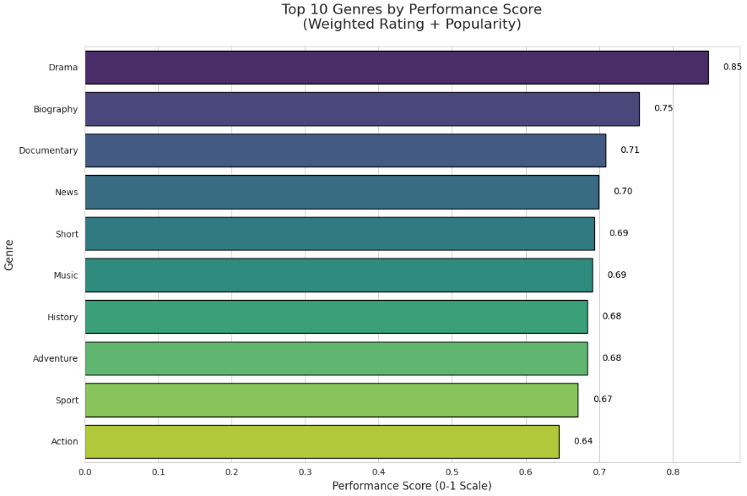
Popularity votes of the films were analysed. The votes were then tied to the films respective genres. The results are as seen in the figure below
The data factored in the top ten most popular genres. ‘Drama’ emerged as the most popular genre with the highest performance score.
20XX | 20XX | 20XX | 20XX

Slide 4

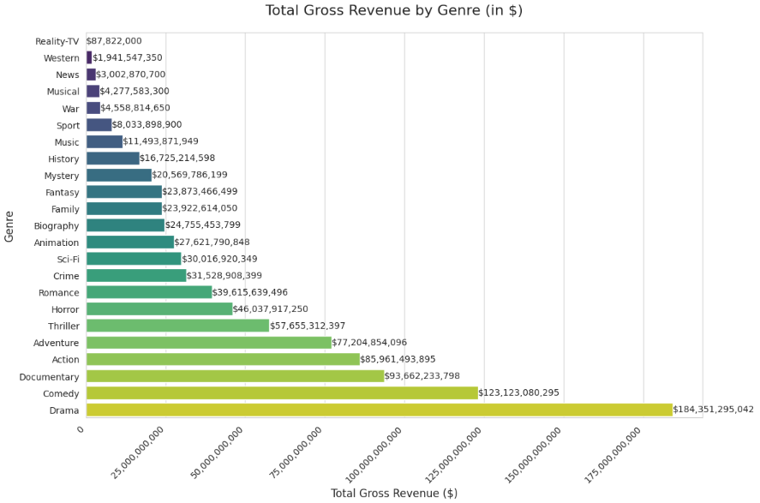
The profitability of each index was also analysed.
The study showed that the genre ‘Drama’ yielded the most profits.

Slide 5
Conclusions and Recommendations
If you want to venture in genres based on popularity, it is advisable to focus on the following genres: Drama, Biography, Documentary, News, Short, Music, History, Adventure, Sport and Action.
If your focus is on profitability, focus on the following genres: Drama, Comedy, Documentary, Action, Adventure, Thriller, Horror, Romance, Crime and Sci-Fi.
Your biasedness should lean towards the following genres: Drama, Documentary, Action and Adventure.

Slide 6

Thank You.

